Slide 1




ECONOMIC ANALYSIS OF SAUDIARABIA FOREIGN TRADE
PROJECT ANALYTICS

Slide 2
02
Hi There....
WELCOME
Data analysis is a powerful tool used to uncover insights, patterns, and trends from raw information. It plays a crucial role in making informed decisions, improving efficiency, and driving innovation across various industries.

Slide 3

ABOUT THE PROJECT
Our project aims to provide clear and concise macroeconomic data for investors and the research community through a comprehensive, aggregated dashboard. This platform is designed to facilitate informed and effective decision-making by offering valuable insights into key economic indicators, enabling users to better understand market trends and economic conditions.

Slide 4




04
WHAT WE DO
Data Collection – We gather raw data from various reliable sources.
Data Cleaning – We process and prepare the data, ensuring accuracy and consistency.
Data Visualization – We transform the data into clear, actionable visual insights.

Slide 5

05
VISION
To empower businesses and researchers by providing clear, accurate, and insightful data analysis, enabling them to make informed decisions and drive sustainable growth.

Slide 6



06
MISSION
To collect, clean, and visualize complex data from diverse sources, transforming it into actionable insights that support informed decision-making and foster innovation across industries.

Slide 7

07
ANALYTICS AREA
Data analysis is a critical tool used to interpret and present information, enabling informed decision-making across various fields. It involves examining datasets to extract meaningful insights, identify trends, and support strategic initiatives. By analyzing data, organizations can optimize processes, enhance performance, and gain a competitive edge.

Slide 8



08
DATA SOURCES
Saudi Central Bank
Saudi General Authority for Statistics.

Slide 9
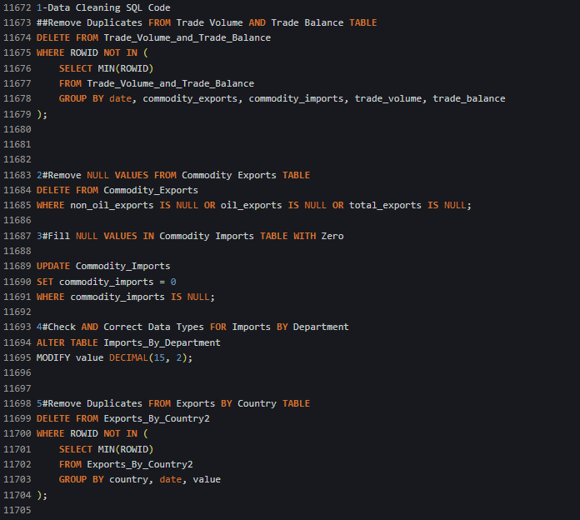
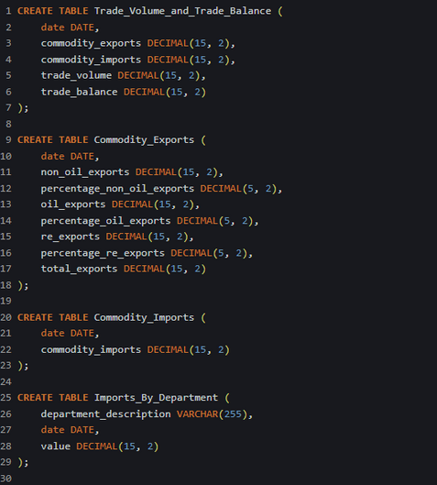
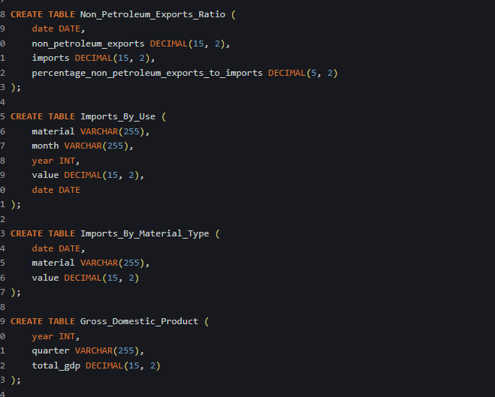
DATA CLEANING
09
In the process of preparing data for analysis, I implemented various SQL techniques to ensure data integrity and accuracy. This included removing duplicates, handling NULL values, and correcting data types across multiple tables. These cleaning steps are essential for generating reliable insights and facilitating informed decision-making.

Slide 10

10
VISUALIZATION DASHBOARD
After cleaning and organizing the data using SQL, the next step is to leverage Power BI for data visualization. The processed data from SQL has been imported into Power BI to create an interactive dashboard. This dashboard allows for dynamic exploration of key metrics, trends, and insights, making it easier for stakeholders to interpret complex data and make data-driven decisions effectively. With Power BI, we can present the data in a visually engaging format, enhancing overall clarity and understanding.

Slide 11
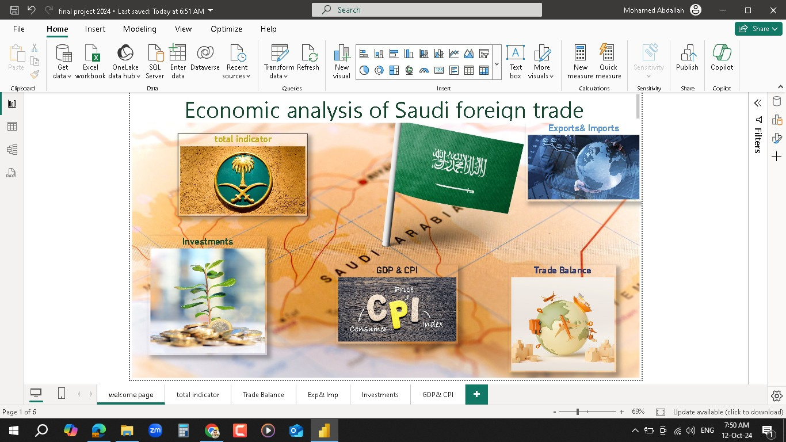
HOME PAGE
11

Slide 12
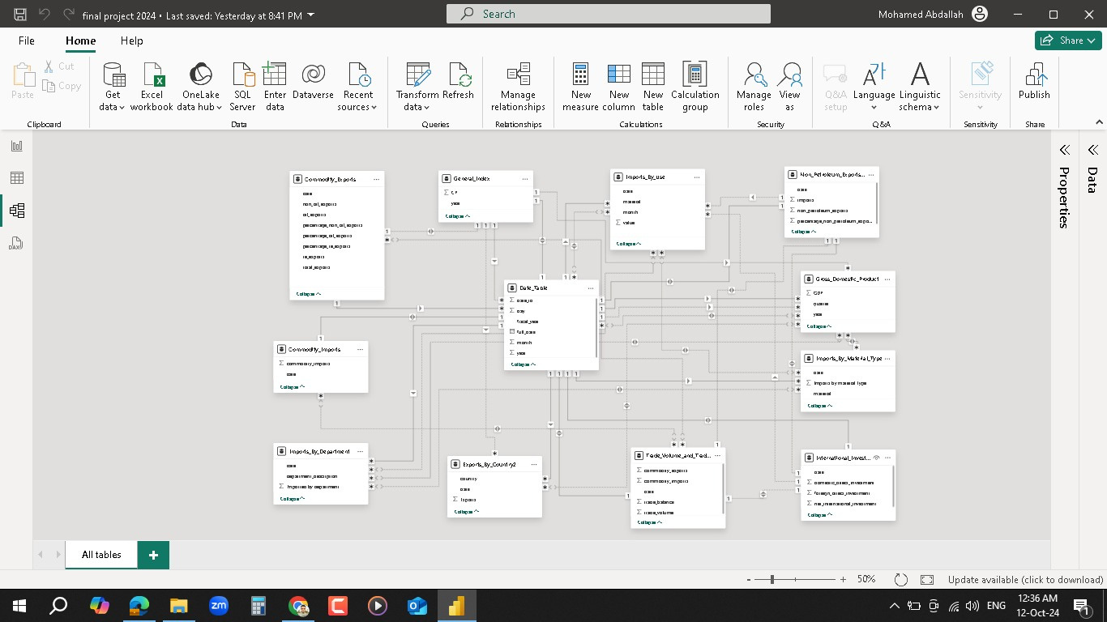
DATA MODEL
12
WHY IS THE DATE TABLE USED AS THE CENTRAL FACT TABLE IN THE DATA MODEL?
In the data model, I created relationships between the tables, with the Date Table serving as the central fact table. This table connects all other tables through their respective date fields, allowing for a cohesive and unified analysis. By linking the data tables through the Date Table, I ensured that the relationships between imports, exports, GDP, and other metrics can be analyzed consistently across time periods, facilitating accurate reporting and visualization in Power BI. This structure supports efficient querying and insightful analysis across multiple data points.

Slide 13
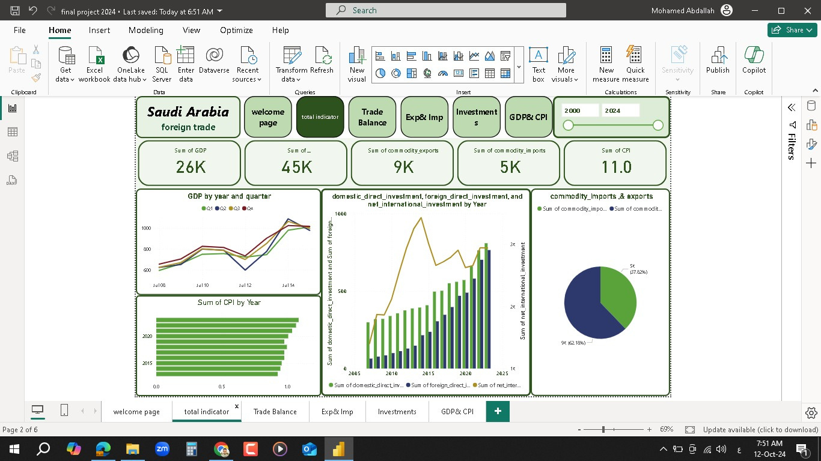
POWER BI
13
HOW DOES THE VISUALIZATION OF KEY ECONOMIC INDICATORS HELP INVESTORS IN DECISION-MAKING?
I created visualizations of key economic indicators for the Saudi economy to provide clear insights for both researchers and investors. These visual tools offer a simplified view of complex data, enabling users to track trends, compare performance, and make well-informed decisions. Through dashboards that highlight crucial metrics like trade volumes, GDP, and investment flows, stakeholders can better understand the economic landscape and assess potential opportunities or risks for investment.

Slide 14
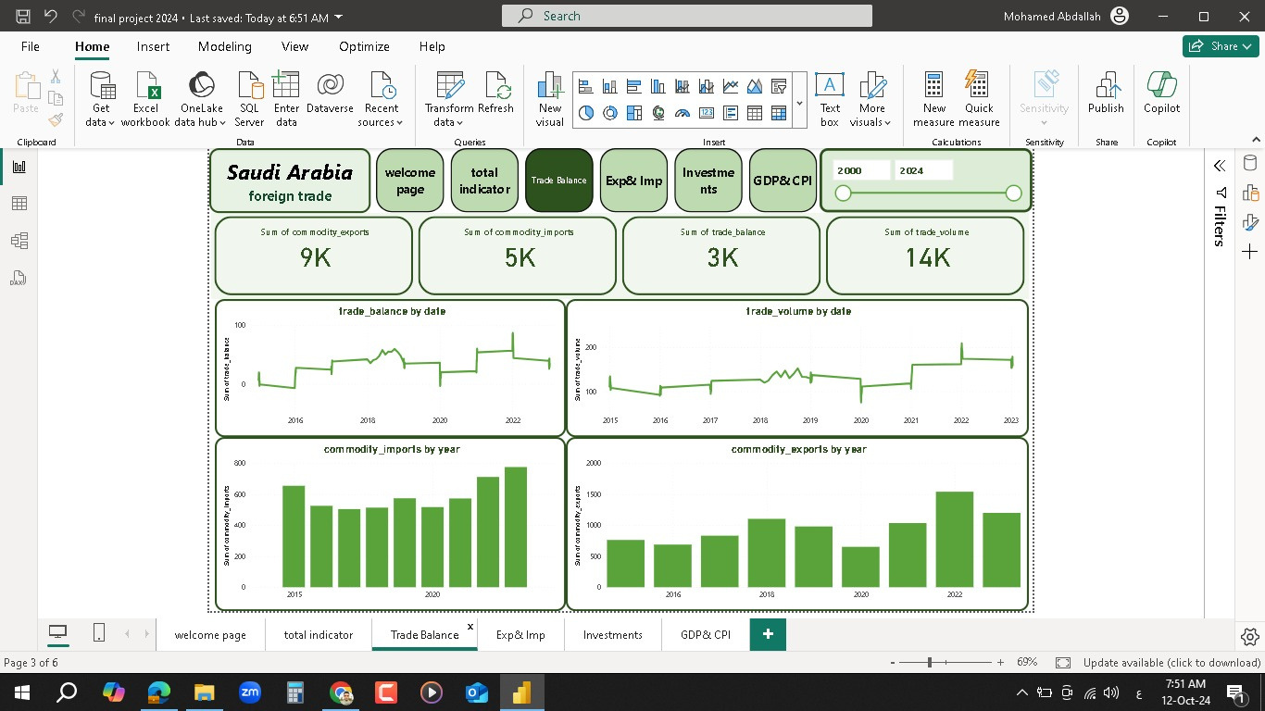
POWER BI
14
HOW DOES A DEEPER FOCUS ON SAUDI TRADE PROVIDE VALUABLE INSIGHTS FOR ECONOMIC ANALYSIS?
By delving deeper into Saudi Arabia's trade activities, we gain a clearer understanding of its economic strengths and areas for improvement. Analyzing export and import patterns, particularly the balance between oil and non-oil commodities, allows for more targeted strategies in diversifying the economy. It helps both researchers and investors to identify trends, assess the impact of global market changes, and make more informed predictions about future trade flows and economic performance. This analysis is essential for guiding policy decisions and optimizing trade relations.

Slide 15
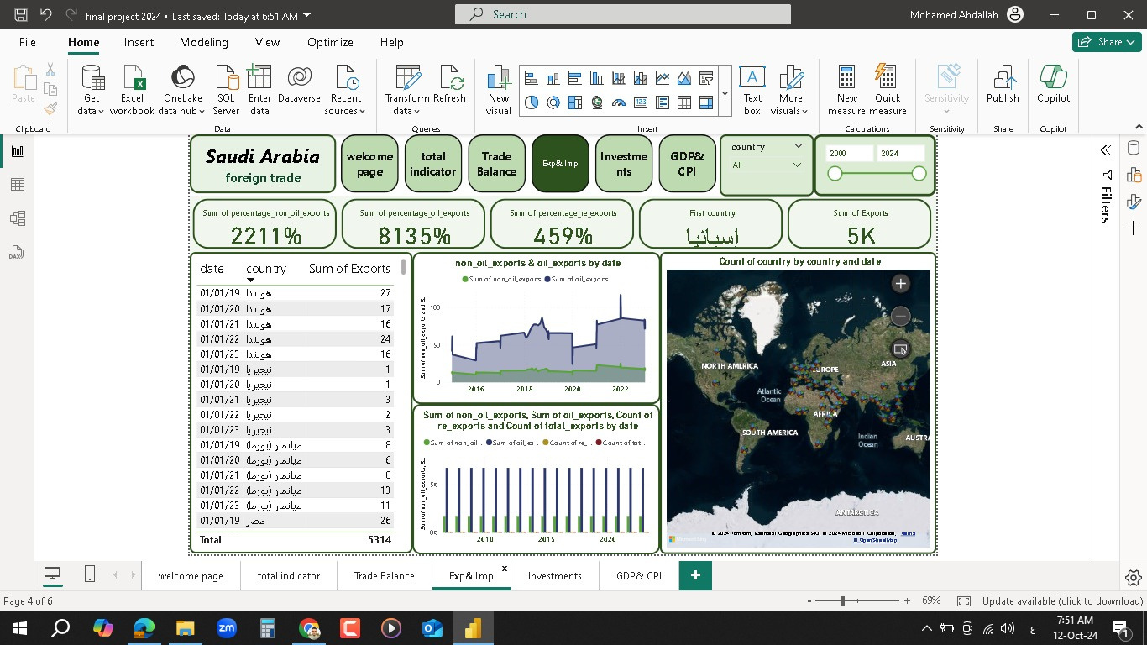
POWER BI
15
WHICH ARE THE MAIN COUNTRIES FROM WHICH SAUDI ARABIA IMPORTS?

Slide 16
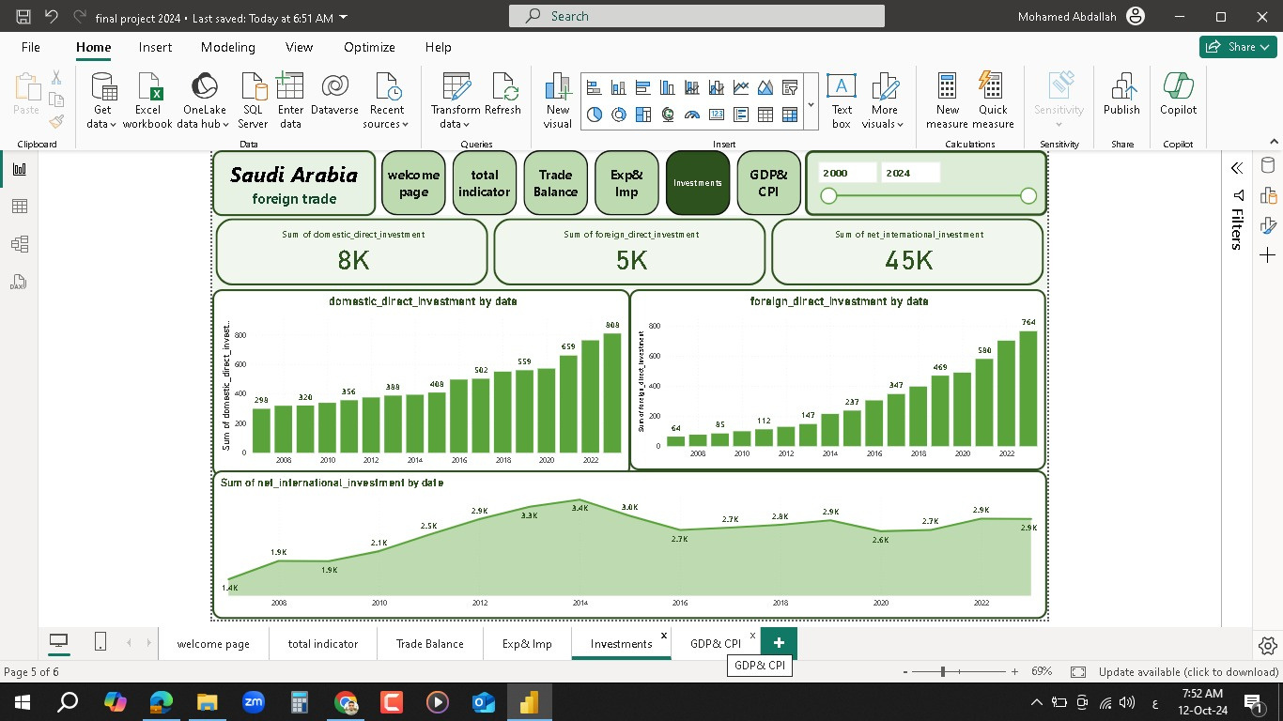
POWER BI
16
WHAT ARE THE KEY FACTORS INFLUENCING INVESTMENT TRENDS IN SAUDI ARABIA?
I focused specifically on the state of investment in Saudi Arabia to highlight its significant importance in economic analysis. Investment is a key driver for achieving sustainable economic development, especially as the Kingdom works towards diversifying its sources of national income by attracting both local and international investments. This emphasis provides a deeper understanding of the role investments play in shaping the economic landscape.

Slide 17
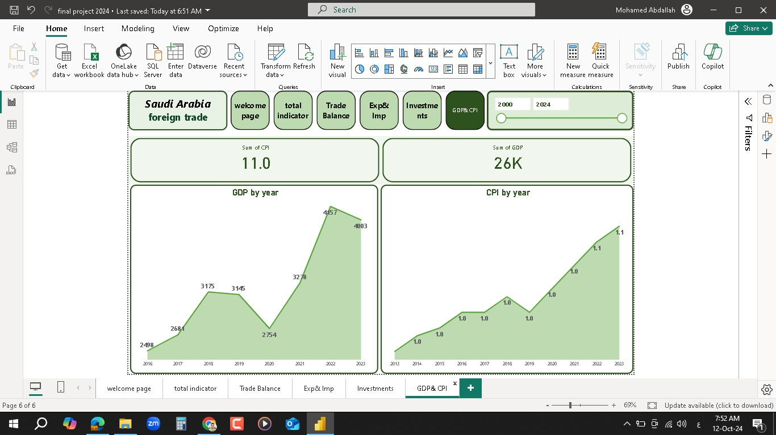
POWER BI
17
HOW DOES INFLATION AFFECT SAUDI ARABIA'S GROSS DOMESTIC PRODUCT (GDP)?
I chose to focus on inflation and Gross Domestic Product (GDP) as key indicators to highlight their impact on Saudi Arabia's economy. Inflation affects consumer purchasing power, leading to changes in spending and investment. High inflation can reduce demand for goods and services, negatively influencing GDP growth. Conversely, moderate inflation may indicate economic growth. By analyzing these two indicators, we can better understand their relationship and overall effect on Saudi Arabia's economic health.

Slide 18

18
work together
I invite you to work with me to achieve our shared goals. Together, we can combine our strengths and insights to drive innovation and success. Your expertise is valuable, and I look forward to collaborating effectively for impactful results.

Slide 19


19
our team
MOHAMED FAWZY ABDELAZIZ
Mohamed Abdallah Elsyed
Arwa Mamdoh Mostafa

Slide 20

LET'S TALK TO US
MAILING ADDRESS
CAIRO
PHONE NUMBER
01111500461
EMAIL ADDRESS
MOHAMED.FAWZY0999@GMAIL.COM

